Slide 1
ClusCite:Effective Citation Recommendation by Information Network-Based Clustering
Date: 2014/10/16
Author: Xiang Ren , Jialu Liu,Xiao Yu , Urvashi Khandelwal , Quanquan Gu , Lidan Wang , Jiawei Han
Source: KDD’14
Advisor: Jia-ling, Koh
Speaker: Sheng-Chih , Chu

Slide 2
Outline
Introduction
Model Overview
Model Learning
Experiment
Conclusion

Slide 3

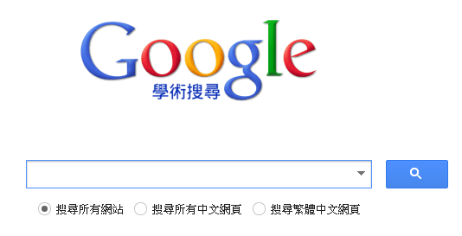
Introduction
Google Scholar
A small set of paper
Based on content
+ KDD?
+citation behavior?
+Social network?
+Dr.Koh?

Slide 4
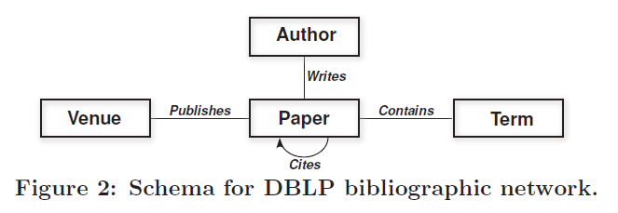
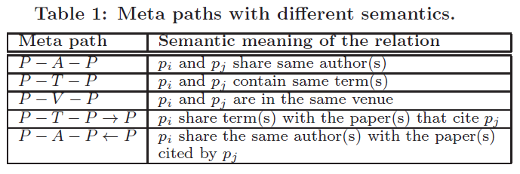
Introduction
What’s heterogeneous network?
What’s Meta-path?

Slide 5
Introduction
Learning model
Heterogenous network
Citation Recommendation

Slide 6
Outline
Introduction
Model Overview
Model Learning
Experiment
Conclusion

Slide 7

Model overview
Define Score function s(q,p) :
q = query manuscript , p = target paper
: how likely query is to belong to the k group.
: the relatedness between q , p according to k-th group.
: the relative importance of p within the k-th group.

Slide 8

Feature Weight
: weight change from importance
: different meta path-based feature

Slide 9

Paper relevance
Ex : k=1~4,
Interest
Group 1
0.6
0.2
Interest
Group 2
p
q
0.5
Interest
Group 3
0.2
Interest
Group 4
0.8

Slide 10

Relative Authority
Affect Relative Authority Score:
1.Published in highly reputed venues.
2.Written by Authority authors.
3.Related to high quality paper.
G() function is propagation function.

Slide 11

Paper-Speif c
query’s group menbership
Interest
Group 1
A
0.8
0.3
Interest
Group 2
q
0.4
V
0.2
Interest
Group 3
0.7
T
0.6
Interest
Group 4

Slide 12
Outline
Introduction
Model Overview
Model Learning
Experiment
Conclusion

Slide 13
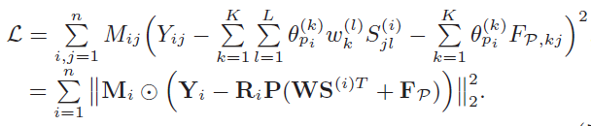
Loss function
Actual value – prediction = loss

Slide 14
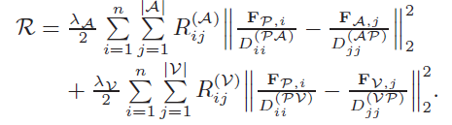
Graph regularization
Normalization on authority vector
R_{K*|A|}
R_{K*n}
R_{|A|*|A|}
R_{n*n}
R_{K*|V|}
R_{|V|*|V|}
i-th column vector of F_{p}
j-th column vector of F_{A}
degree of P_{i} in R^{A}
degree of A_{j} in R^{A}
Notes:
為了怕popular的問題影響權威值必須正規化

Slide 15
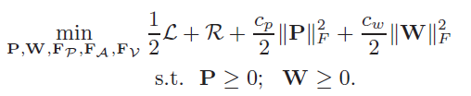
Joint optimization problem
Joint optimization problem :
Tikhonov rehularizes

Slide 16
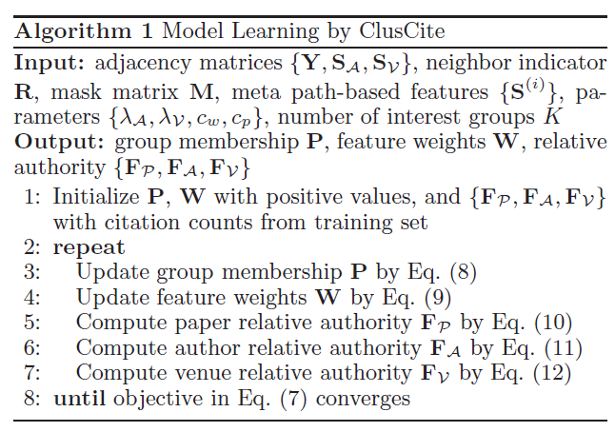
ClusCite Algorithm

Slide 17
Outline
Introduction
Model Overview
Model Learning
Experiment
Conclusion

Slide 18
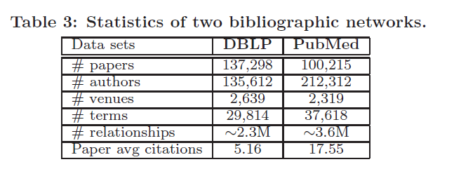
Experiment
Data Set :DBLP dataset2 and PubMed dataset3

Slide 19
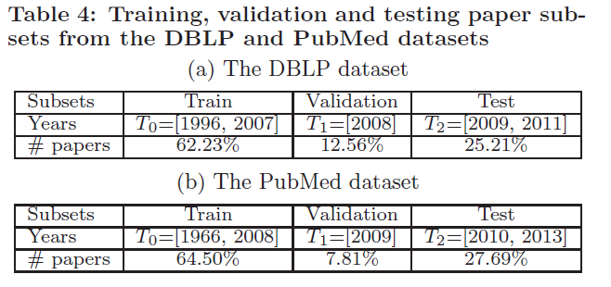
Process work

Slide 20
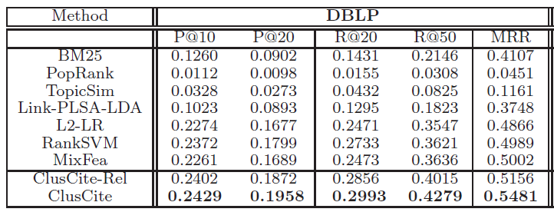
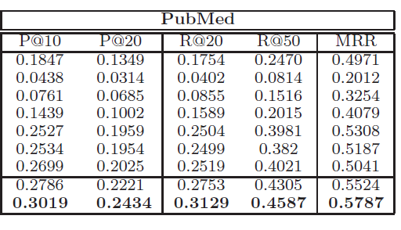

Slide 21
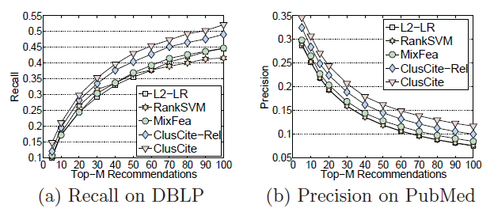
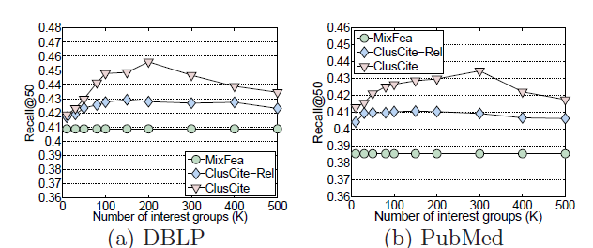

Slide 22
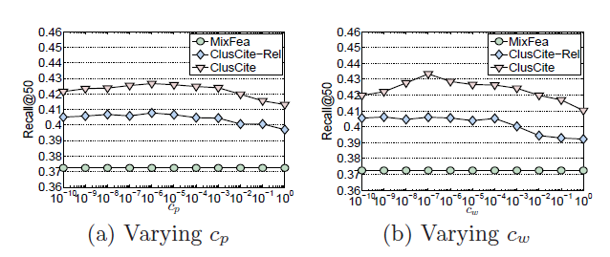
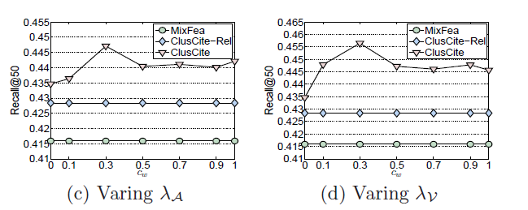

Slide 23
Conclusion
Propose novel cluster-based framework to satisfy a user’s diverse citation intents.
Develop efficient algorithm and better performance
this paper is good.

